Slide 1
Attention Based Spatial-Temporal Graph Convolutional Networks for Traffic Flow Forecasting
AAAI 2019

Slide 2
Background
Many countries are committed to developing Intelligent Transportation System (ITS)
Traffic forecasting is an indispensable part of ITS
Serious economic loss caused by traffic congestion
Value
Traffic management & Traffic capacity
Risk assessment
Public safety

Slide 3

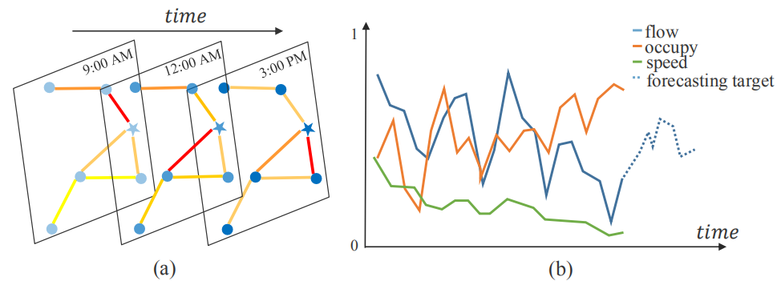
Traffic Networks
Spatial
A traffic network:
Temporal
Each node on the traffic network G detects F measurements with
the same sampling frequency.

Slide 4
Traffic Flow Forecasting
Given all kinds of the historical measurements of all the nodes on
the traffic network over past time slices, predict future traffic flow sequences of all the nodes over the following time slices.

Slide 5
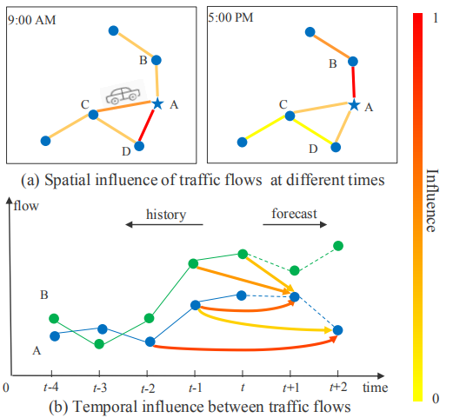
Dynamical spatial-temporal correlations
Spatial
Temporal

Slide 6
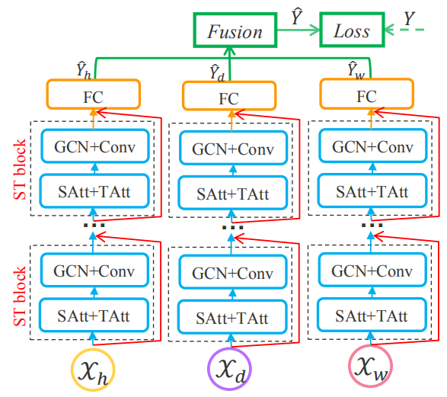
Attention based Spatial-Temporal Graph Convolutional Network
ASTGCN
SAtt :Spatial Attention
TAtt :Temporal Attention
GCN :Graph Convolution
Conv :Convolution

Slide 7
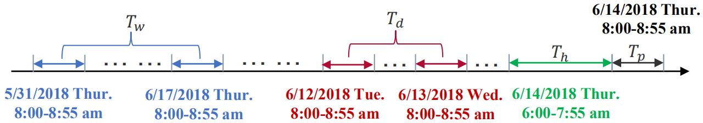
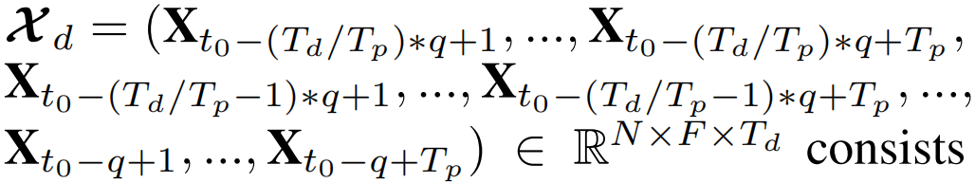
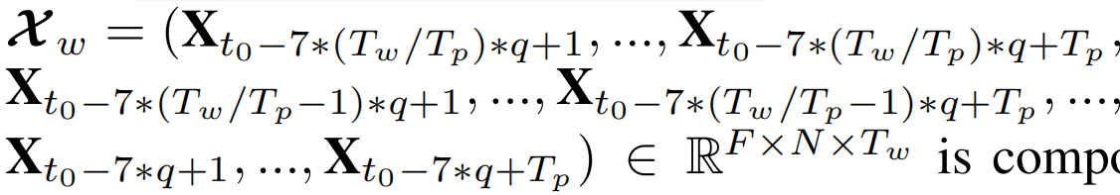
The recent segment:
The daily-periodic segment:
The weekly-periodic segment:

Slide 8
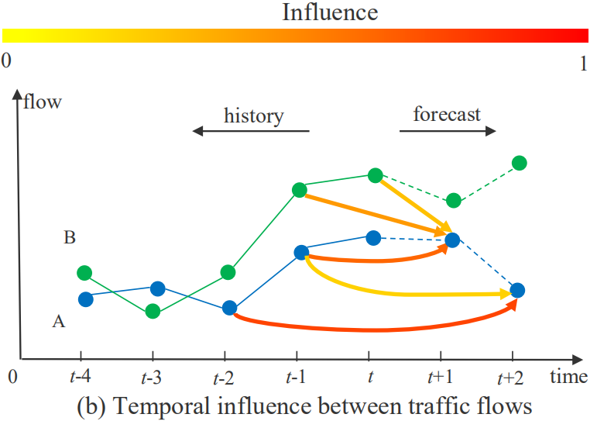
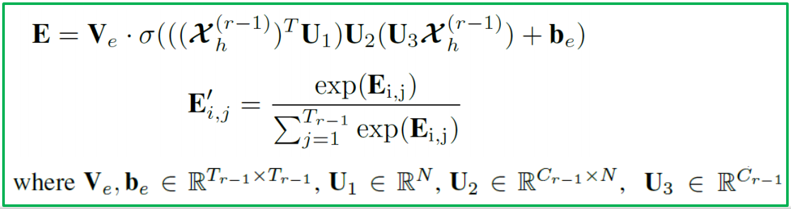
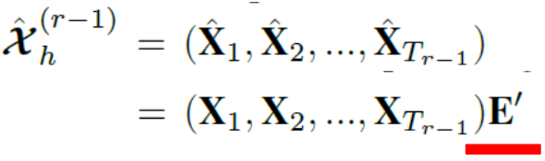
Spatial-Temporal Attention
Temporal attention

Slide 9
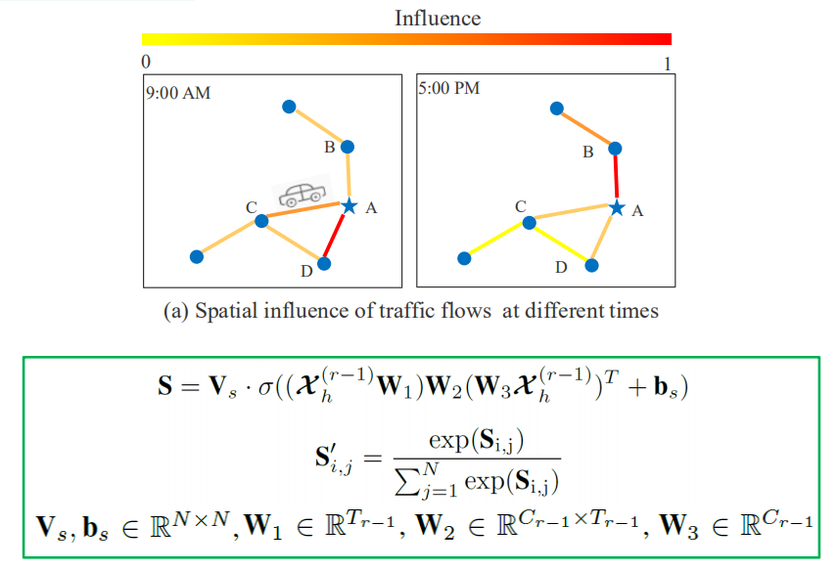
Spatial-Temporal Attention
Spatial attention

Slide 10
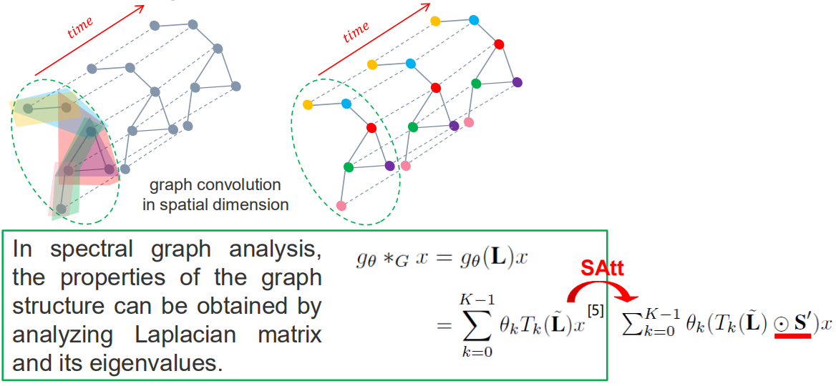
Spatial-Temporal Convolution
Spatial graph convolution

Slide 11
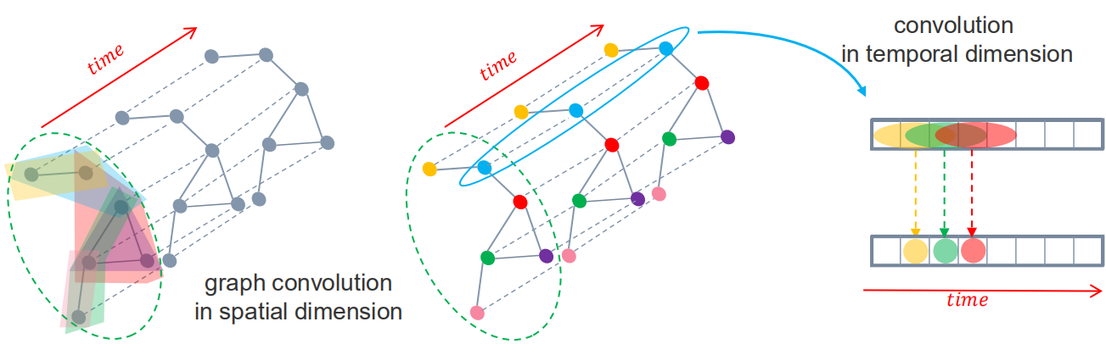
Spatial-Temporal Convolution
Temporal convolution

Slide 12
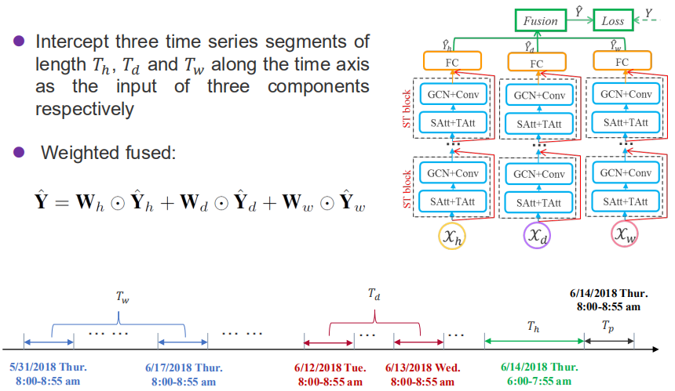
Multi-Component Fusion

Slide 13
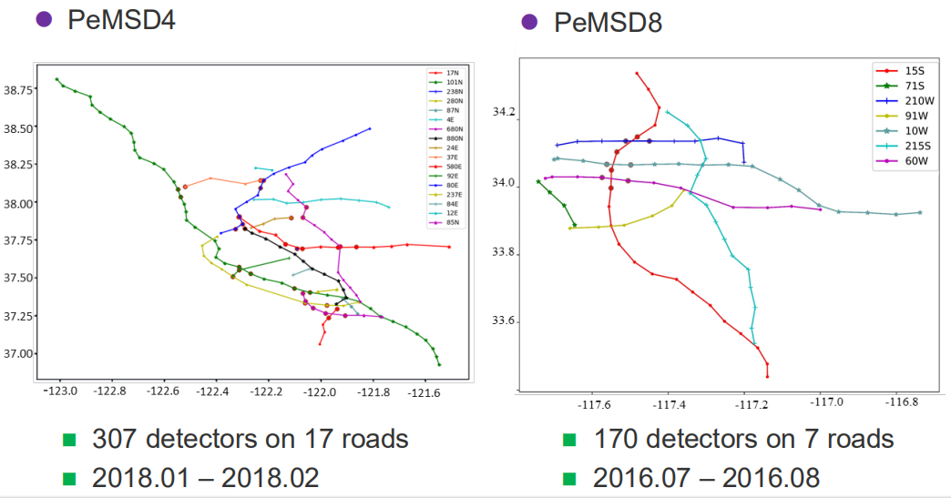
Experiments
Datasets
Three measurements (every 5min)：total flow, average speed, average occupancy
Goal：predicting the traffic flow over one hour in the future.

Slide 14
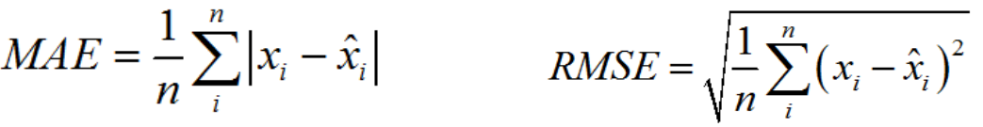
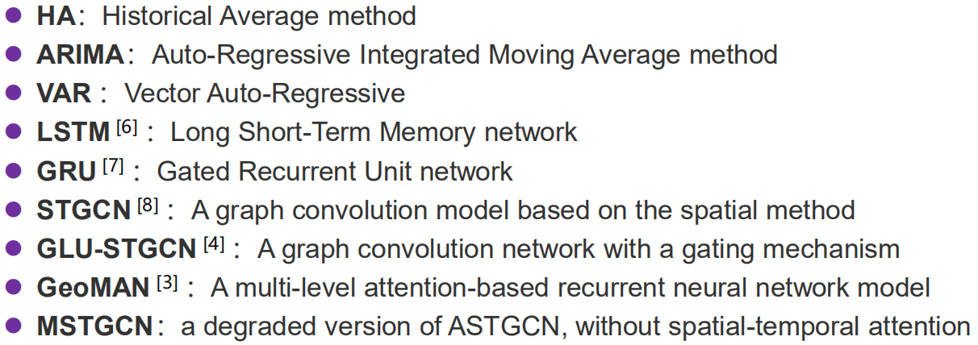
Evaluation Metrics
Baselines

Slide 15
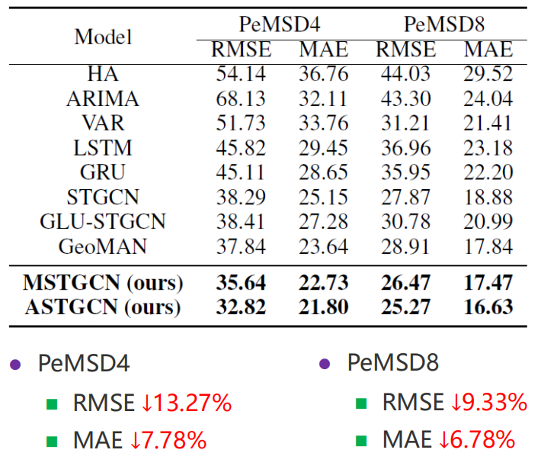
Average results of traffic flow prediction performance over the next one hour

Slide 16
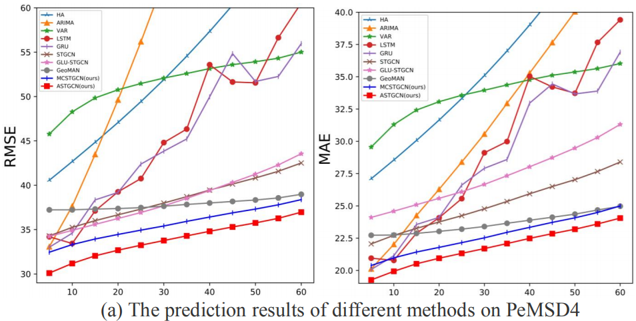
Changes of prediction performance as the prediction interval increases

Slide 17
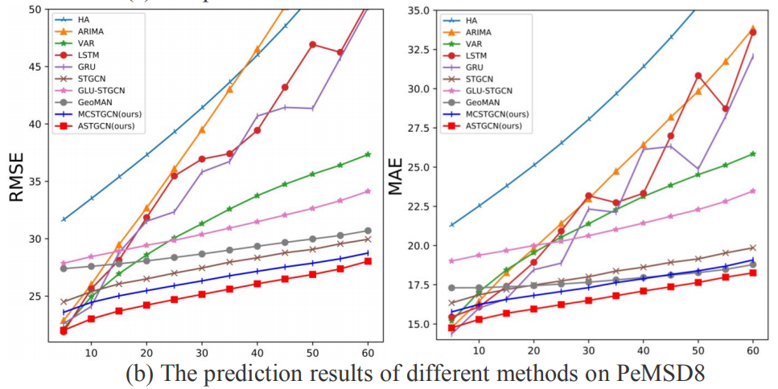
Changes of prediction performance as the prediction interval increases

Slide 18
总结
1）开发了一个时空注意力机制去学习交通数据的动态时空相关性。具体来说，空间注意力机制被用来对不同位置的空间相关性进行建模。时间注意力机制被用来捕获不同时刻的动态时间相关性；
2）设计了一个新颖的时空卷积模块，用于对交通数据的时空相关性进行建模。它包含图卷积（能够从原始图交通网络结构中捕获空间特征）；
3）在真实的公路交通数据集上进行了大量的实验，验证了模型与现有的基本模型相比有更好的预测效果。

